Slide 1
Traditional Poster Supplements

Slide 2
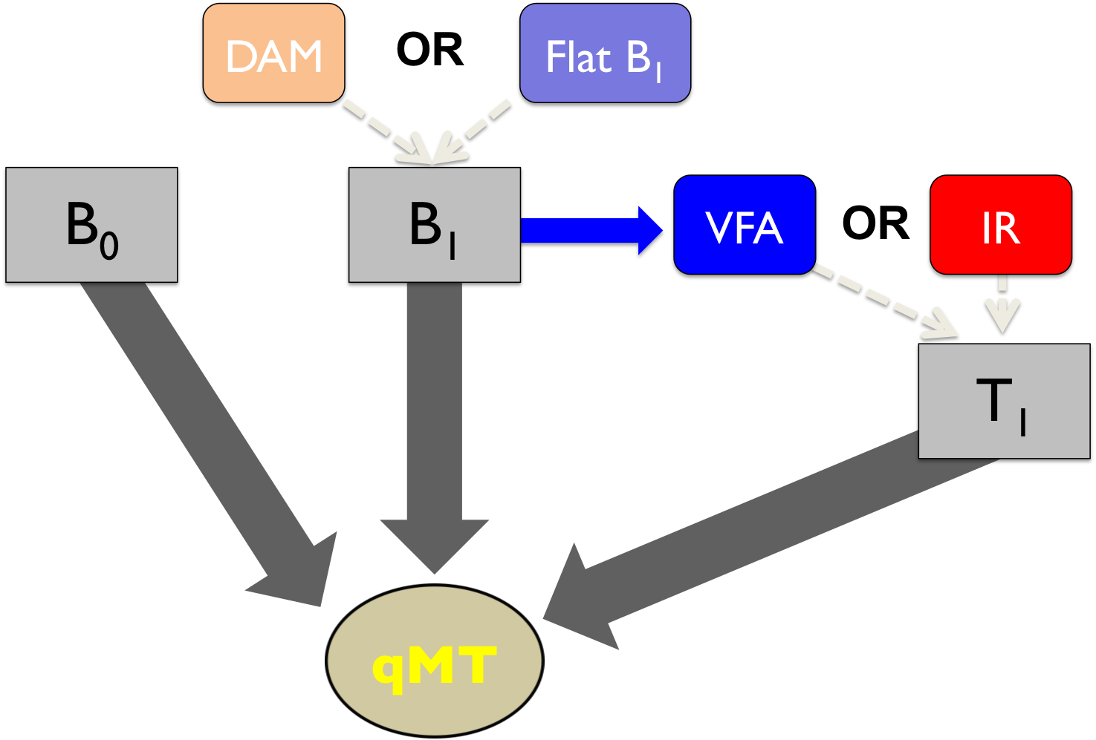

Slide 3
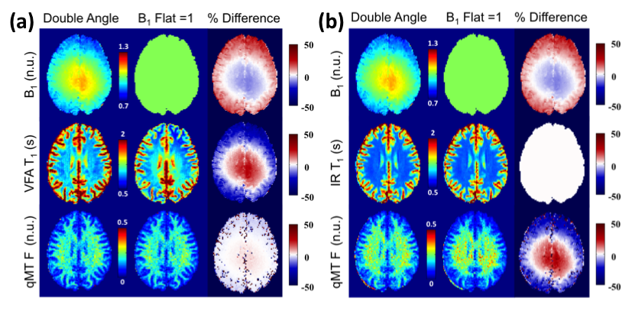

Slide 5
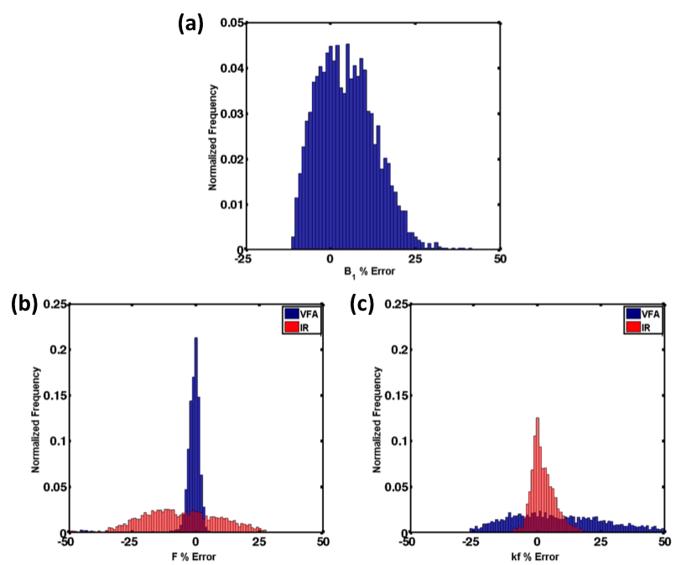

Slide 6
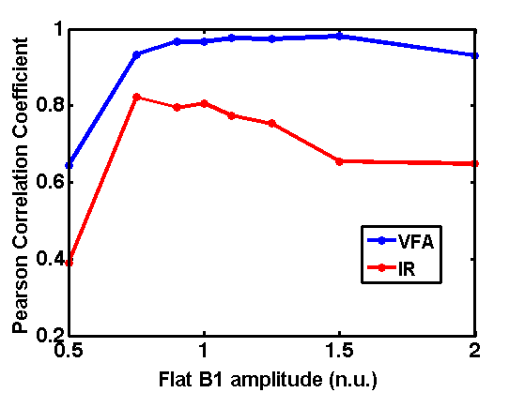
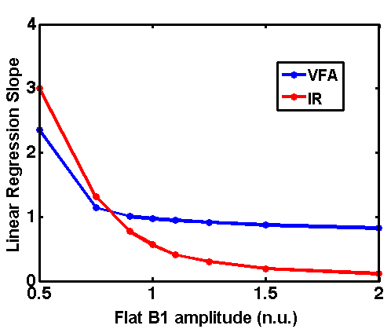

Slide 7
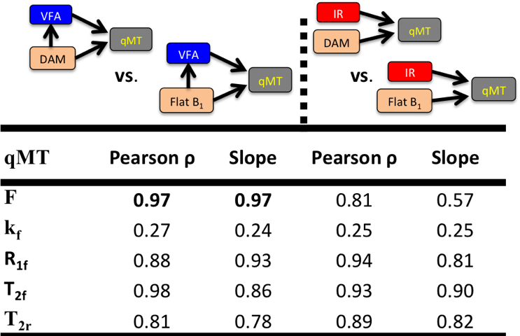

Slide 8
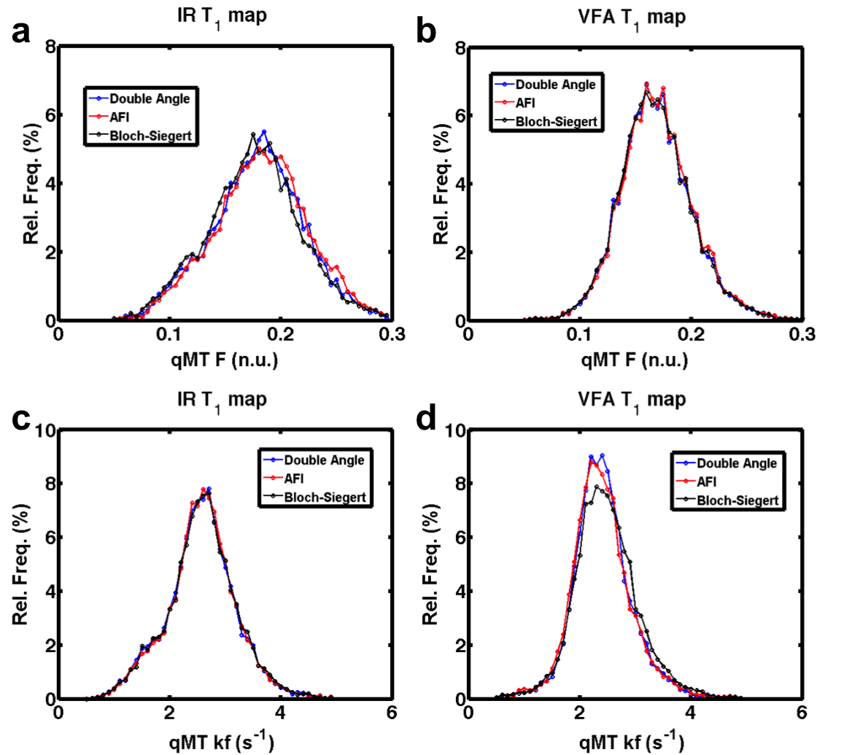

Slide 9
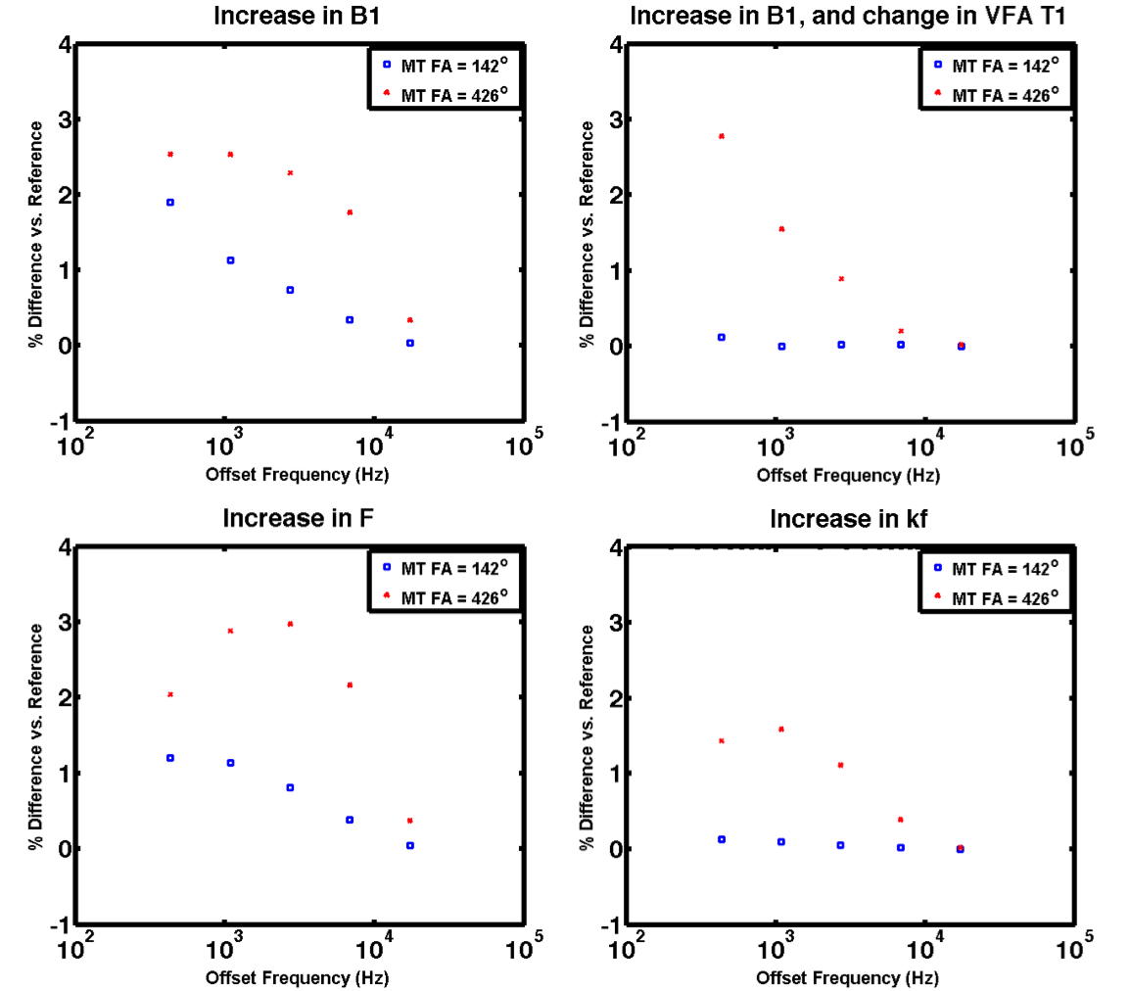

Slide 10
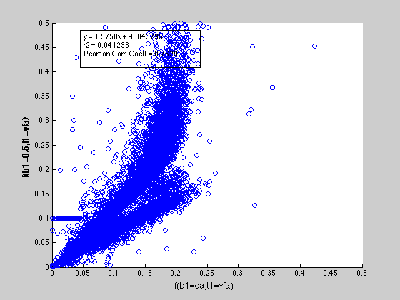
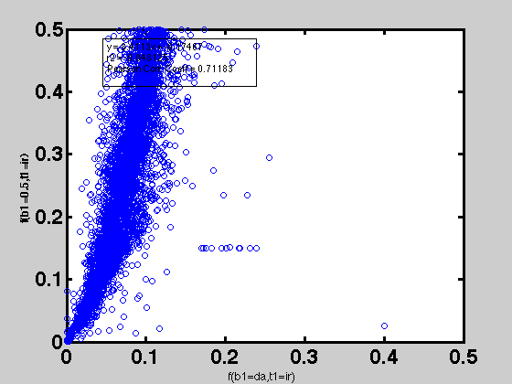
qMT F parameter comparison
B1 measured vs. B1 flat = 0.5
VFA | IR

Slide 11
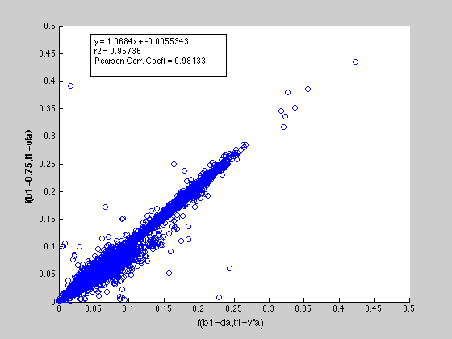
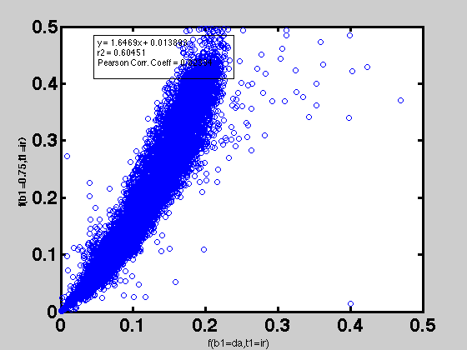
qMT F parameter comparison
B1 measured vs. B1 flat = 0.75
VFA | IR

Slide 12
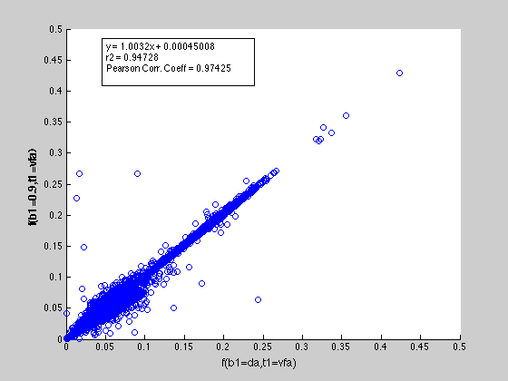
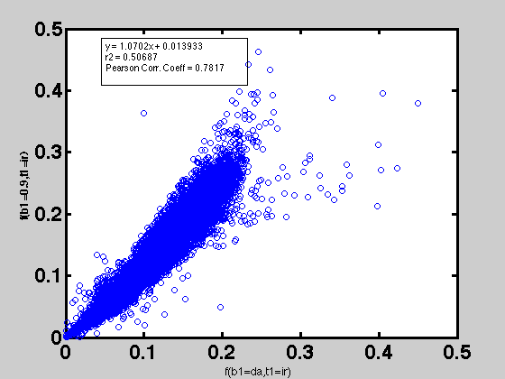
qMT F parameter comparison
B1 measured vs. B1 flat = 0.9
VFA | IR

Slide 13
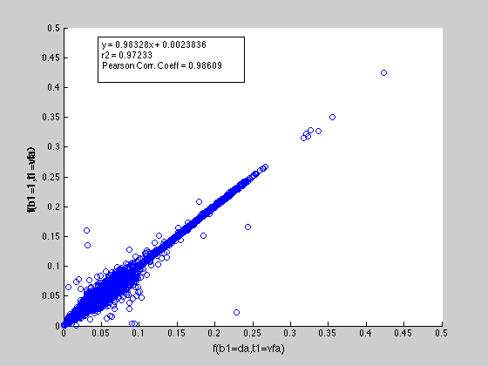
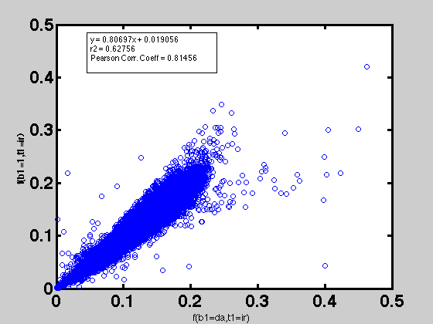
qMT F parameter comparison
B1 measured vs. B1 flat = 1
VFA | IR

Slide 14
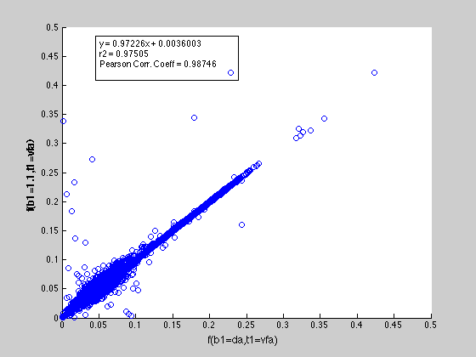
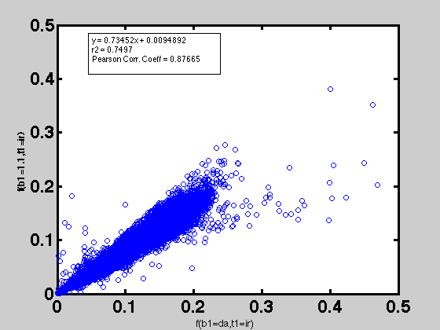
qMT F parameter comparison
B1 measured vs. B1 flat = 1.1
VFA | IR

Slide 15

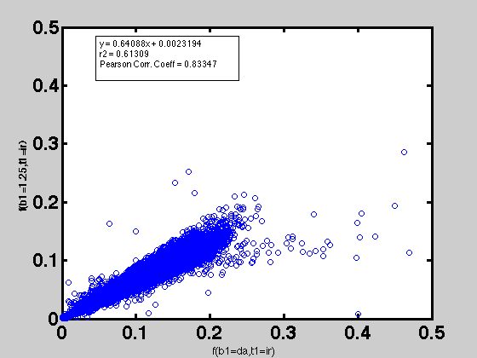
qMT F parameter comparison
B1 measured vs. B1 flat = 1.25
VFA | IR

Slide 16
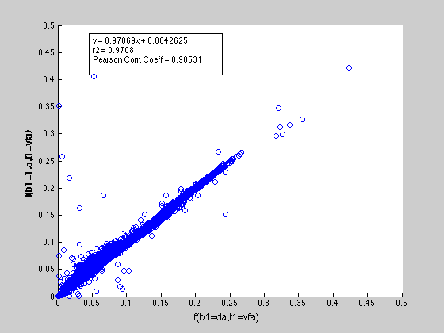
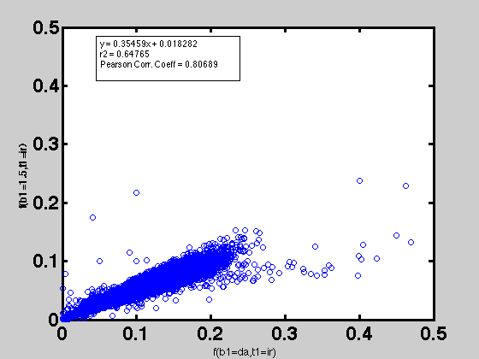
qMT F parameter comparison
B1 measured vs. B1 flat = 1.5
VFA | IR

Slide 17
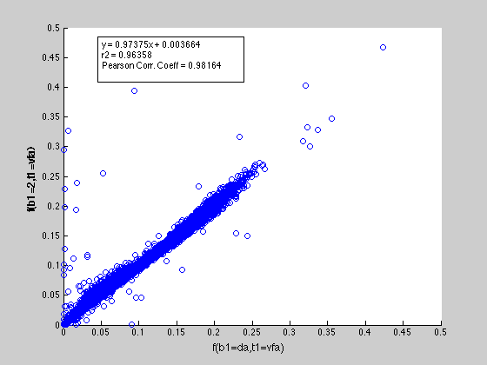
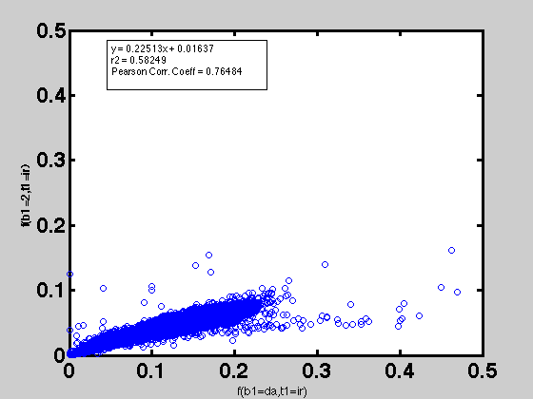
qMT F parameter comparison
B1 measured vs. B1 flat = 2
VFA | IR

Slide 18
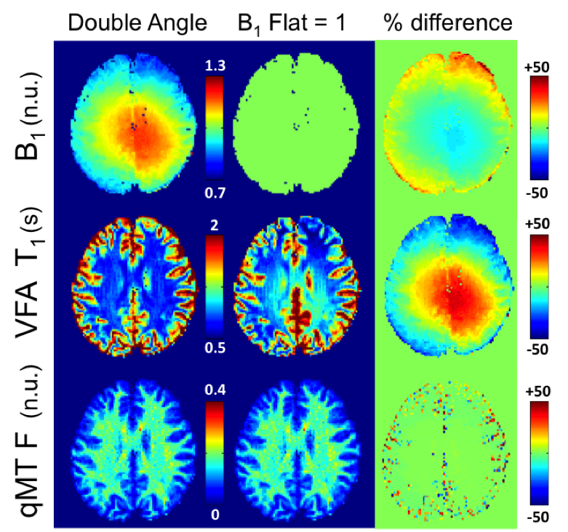

Slide 19
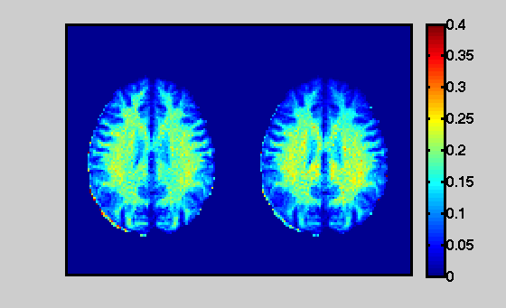
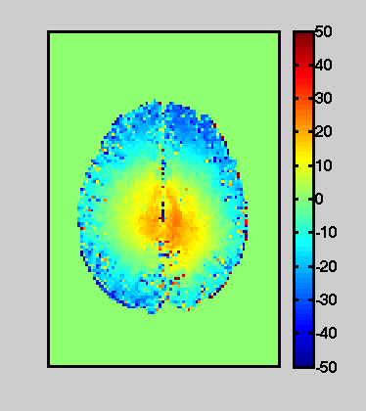
qMT F map
% Difference
IR+(B1=DA)
IR+(B1=1)

